Slide 1
GIG TAP Assessment 1
Ryan Tan yu
Automated deployment of Cloud infrastructure

Slide 2
Links
Automated Cloud Infrastructure – https://github.com/ryanYtan/auto-provision
Web Application Repo – https://github.com/ryanYtan/redwood-app
Web Application – https://redwood-test-app.link/
Deployment Video – https://www.youtube.com/watch?v=rIHAPhSVKYU
Recommended to watch at 1.5x or 2.0x speed
Please let me know when I can decommission the infrastructure, due to the AWS bills.

Slide 3
Interpretations of Requirements (1)
(1) The infrastructure must be provisioned on AWS automatically without manual intervention
I have understood “without manual intervention” to mean “I don’t have to go into the AWS console to manually change settings”, everything should be done via automated or near-automated deployment from e.g. the terminal. This requirement is fulfilled via Terraform.
(2) The web application service should still be up when an AWS availability zone fails
The web application is to be deployed across multiple AZs.
(3) The web traffic should be load balanced across multiple availability zones
There should be a load balancer between the application and the internet that redirects traffic to the application running on multiple AZs

Slide 4
Interpretations of Requirements (2)
(4) Any changes to the infrastructure must be performed without manual intervention
Like the first requirement, any changes should not be done via AWS console, instead via modifying the IaC solution
(5) The design should be based on best practices with security in mind
This is a general requirement that I’ve hoped that I’ve achieved in my architecture
The overarching requirement is that this infrastructure must be portable over different applications. So, the Terraform IaC must be parametrized to allow customization.

Slide 5
Web Application “Redwood”
The example web application (named “Redwood”) is a simple Flask app for an e-commerce website
The front-end is not great. Sorry about that, I’m not very good at front-end development.
Redwood is containerized via Docker, and uploaded onto Docker Hub
Features include
User sign-in/up
Session management
Connection to a PostgreSQL database (either local or RDS) to store products & user data
Users can sell and buy products

Slide 6
AWS Architecture
The following slides shows the overall architecture of the AWS infrastructure used to migrate this application to the Cloud.

Slide 7
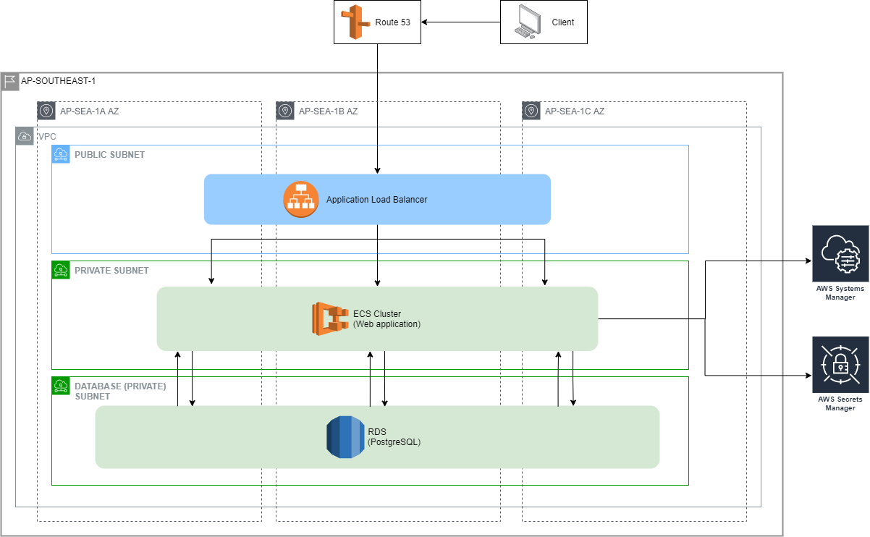

Slide 8
AWS Architecture (Key Points 1)
1 VPC in ap-southeast-1
3 logical subnets (public, private, database), each with 3 CIDR blocks for 3 availability zones (AZs)\
Traffic incoming from the client is routed through Route 53 and passes through an Application Load Balancer (ALB)
The ALB is deployed in a public subnet across the 3 AZs. It is the only resource to be deployed in the public subnet
ALB allows all traffic from the internet, and routes them to the ECS task listening on port 8080
ALB also has the typical redirect from HTTP:80 to HTTPS:443

Slide 9
AWS Architecture (Key Points 2)
The webapp is deployed on AWS ECS using FARGATE
FARGATE allows for auto-scaling and configuration of virtual machine clusters without explicit management of resources
By specifying the private subnets when creating the ECS Service, the service can be configured to split tasks across different AZs for high availability
ECS Task only accepts connections coming in on the port it’s listening on (Redwood uses 8080)
When doing a redeployment of the ECS Service when a new container image of the application is deployed, FARGATE also automatically spins up new tasks before destroying old ones
The PostgreSQL database hosted on AWS RDS
RDS has a function to automatically manage and rotate the DB username and password in Secrets Manager. Consequently, the ECS Task running the webapp has the relevant IAM permissions to access these secrets via Terraform
Other DB specific data (name of the database, exposed port & database endpoint) is stored in Systems Manager Parameter Store. The relevant IAM permissions for these are also granted to the ECS task via Terraform
The RDS instance is also deployed across multiple AZs for higher availability

Slide 10
AWS Architecture (Key Points 3)
All infrastructure is fully deployed (and modifiable) via Terraform
The exception is buying the actual domain (redwood-test-app.link) from Route 53
Any containerized application running with an RDBMS should be able to use this configuration with little configuration
I’ve attempted to parametrize the configuration so applications with different requirements can easily change the config

Slide 11
Caveats
The proposed web app is supposed to originally run on Windows Server 2019. I developed the app on Unix, but since it’s containerized it should run fine on WinServer 2019
Different architectured applications will have drastically different configurations, such as provisioning an RDS vs DynamoDB instance for RDBMS vs NoSQL solutions
In such cases, I’ve arbitrarily selected one over the other convenient for the web app I’ve created, but compartmentalized the modules (db, ecs) such that any modifications specific to each module can be done separately
Any application must be modified to accommodate moving to the Cloud e.g., to handle querying Secrets Manager for secrets. In other words, the process cannot be fully automated and some grunt work needs to be done to the application before deployment

Slide 12
Areas for Improvement
Possible conditional deployment (or just a different template) for application architectural differences such as RDBMS vs NoSQL
Deployment to different service for non-containerized applications
Link the web application build + docker push + terraform apply into a single pipeline, such as for CI/CD
Use AWS ECR to leverage using AWS services (and to have a private registry) vs using Docker Hub
Deployment to multiple environments (Prod, Staging, etc)
Tagging of Resources

